Slide 1
Our Training and Library

Slide 2
GDC Training Milestones
Pre-GDC – Kent Beck consults on eXtreme Delivery
2004 - GDC established
2007 - First ScrumMaster
2007 - Foundation Training Program
2008 - Boot Camp Round 1
2008 - CMMI SCAMPI Class A appraised Level 3
2008 - 8 Certified ScrumMasters
2010 – CST/SA-REP
2011 – CSD Certification Programs
2011 – CMMI SCAMPI Class A appraised Level 5
2015 – Boot Camp Round 17, 18
– Security and Confidential Training
2016 – Boot Camp Round 19

Slide 3
Training Overview
Generalized Training
New Employee Orientation
Video training program - iPod Nano’s and video library
Technical Training
GDC Specific Training
Foundation Training
Boot Camp
Gap Training
Project Specific Training
Product/Partner Training
Soft Skills Training
Career Management
Leadership
Train the Occasional Trainer
CoE Training

Slide 4
Foundation Training - Objectives

Slide 5
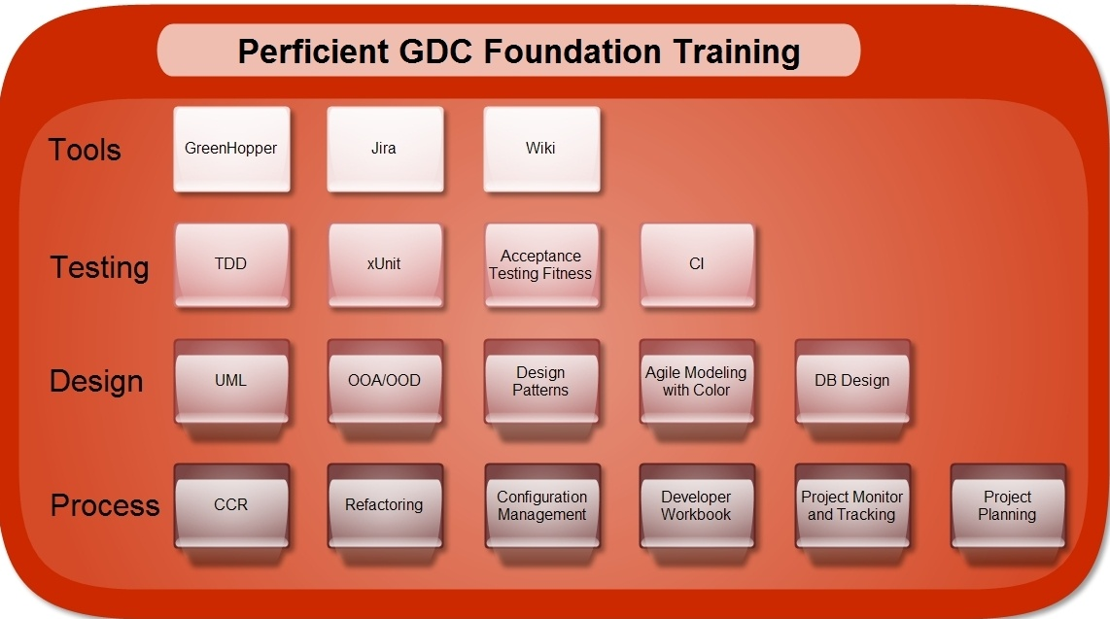
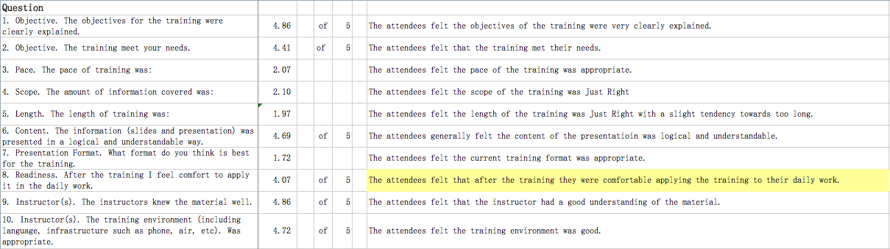
Foundation Training - Curriculum

Slide 6
Boot Camp - Objectives

Slide 7
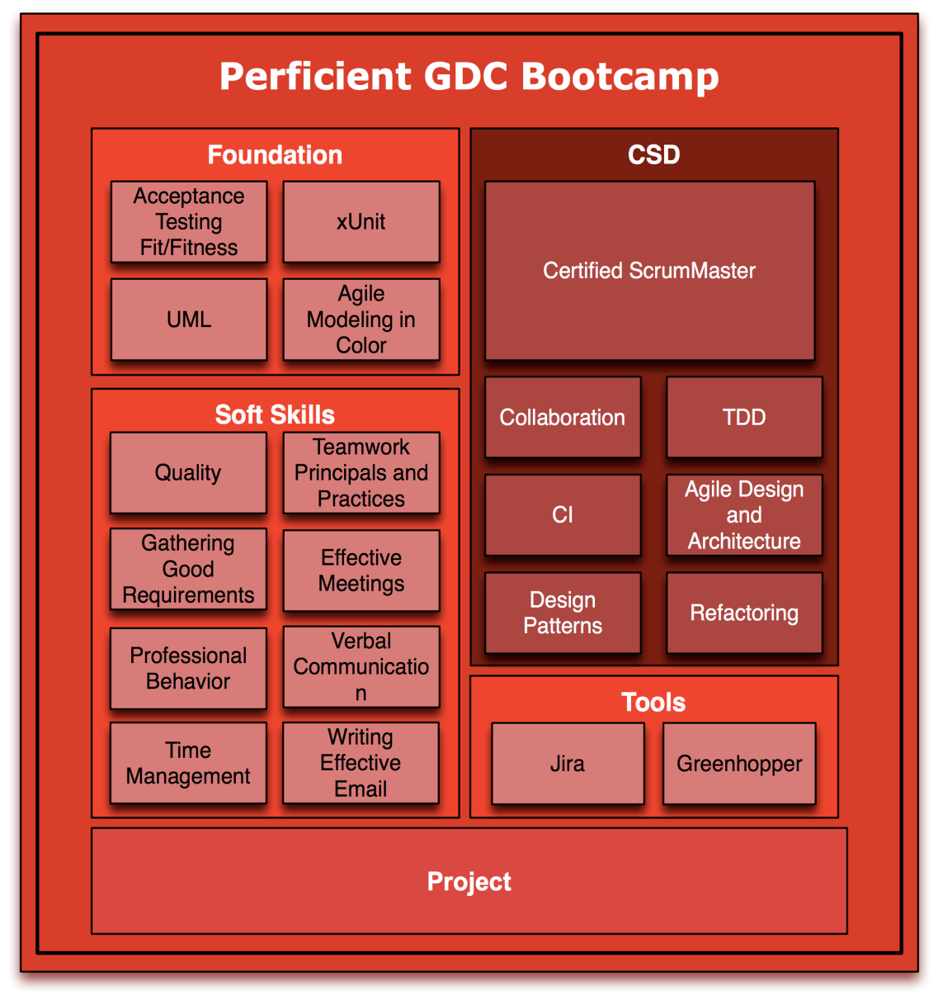
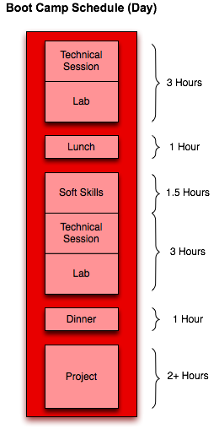
Boot Camp - Curriculum
All Foundation Training
Additional Soft Skills Training
Project - Put skills into practice

Slide 8

Project Specific Training
PSI
BEA WebLogic and BPM
Avaya TT
Seibel
Future Projects
Could be anything -- welcome to the world of consulting

Slide 9
Product Specific Training
Oracle Siebel
Already conducted training for Avaya TT project
We will build a center of excellence around Siebel
Tibco
New focus across Tibco product suite
Training to be arranged in mid-year timeframe
BEA
Recently participated in WLI and ALSB training
Sterling/GIS
Documentum
IBM Websphere
Websphere Application Server
Websphere Portal Server
Websphere Commerce

Slide 10
Soft Skill Training
Career Planning
Being a Good Consultant
Leadership
Train the Occasional Trainer
Presentation Skills
Communication Skills
English Training

Slide 11
External Training - Policy
Process for external training application
Apply in advance
Successfully completes the training including passing any related certification exams
Sign training agreement
Submit expense report
Rules and regulation
Submit training application online
Service item
First come, first serve
If the training expense is paid in USD the expense should be exchanged into RMB
Ask finance for expense report detail

Slide 12
Training Materials
Training materials can be found at
X:\Public\Public.Training
For example, video training materials can be found at
X:\Public\Public.Training
− iPod Nano’s can be checked out from IT
Future training will be captured on video
Training polices and processes on SharePoint

Slide 13
Training relative systems
TPT & Training APP
Training tracking system
Training tracking system is used to mange our external and internal training expense application and trainring agreements.
Perficient GDC Test Center
Perficient GDC Test Center is a online paper testing center.

Slide 14
Training System
TPT
http://tpt/web/guest/login
Submit training request
View training courses catalog
Register a training course
Submit training feedback

Slide 15
Training System - APP
Features:
Have a register before the training
Receive the reminding before the training
Check in when enter the training room
Submit feedback after the training
Features:

Slide 16
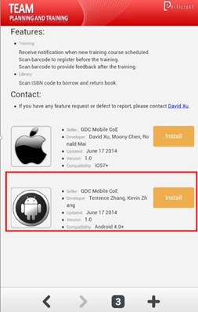
Training System - APP
How to install training APP?
Step 1: Visit the website: 10.2.1.74:8080 via your smart phone
Step 2: Choose the right compatibility for your smart phone (IOS7+ or Android 4.0+)

Slide 17
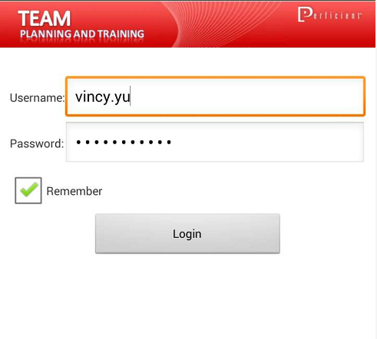
Training System - APP
How to install the APP of training?
Step 3: Download and install
Step 4: Login it with your Perficient account

Slide 18
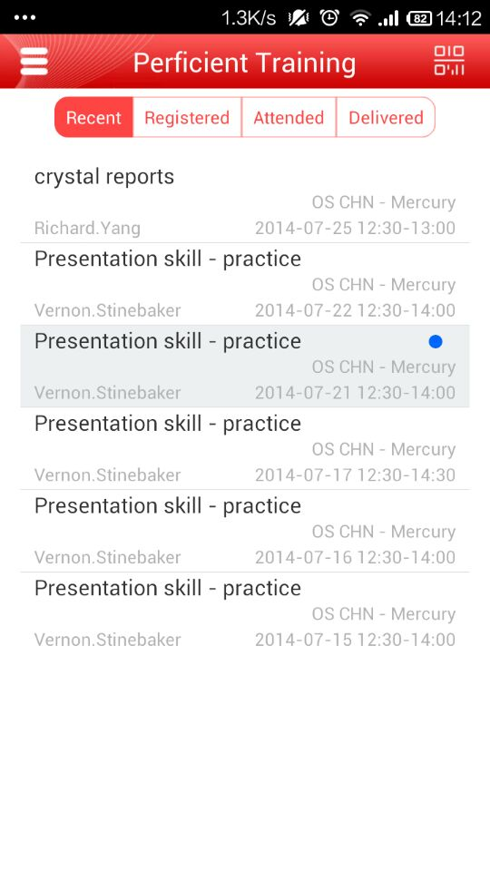
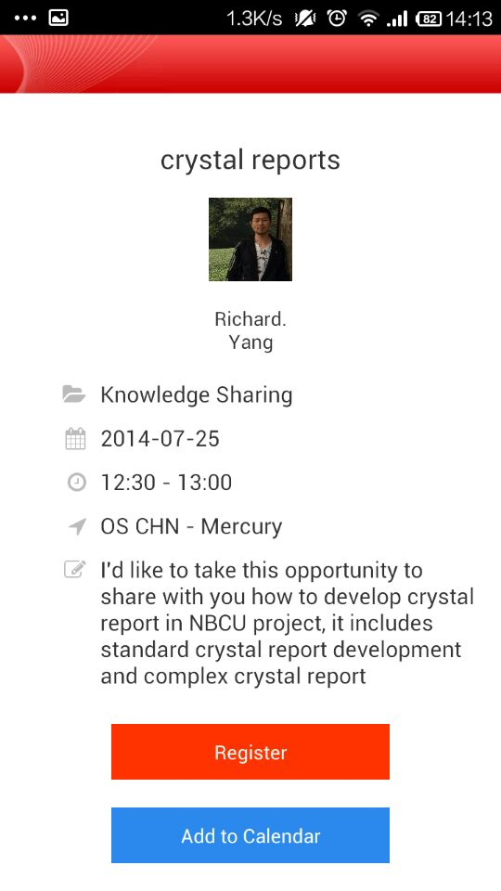
Training System - APP

Slide 19
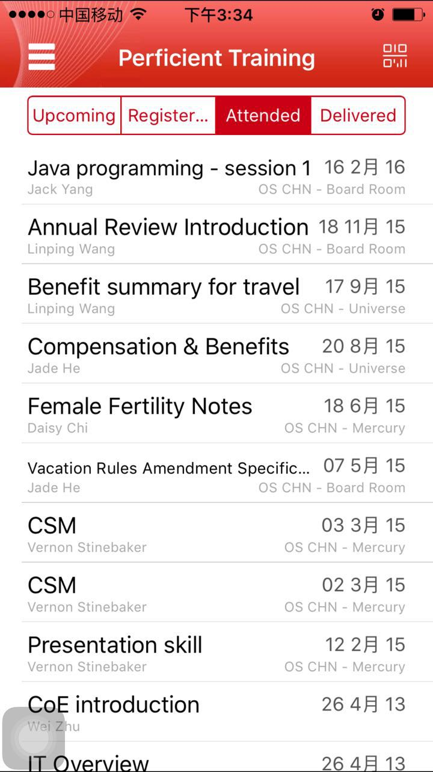
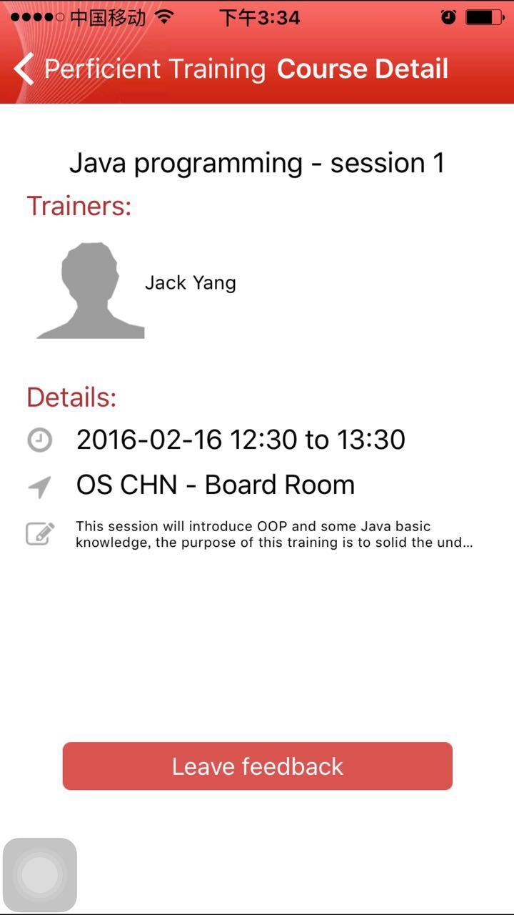
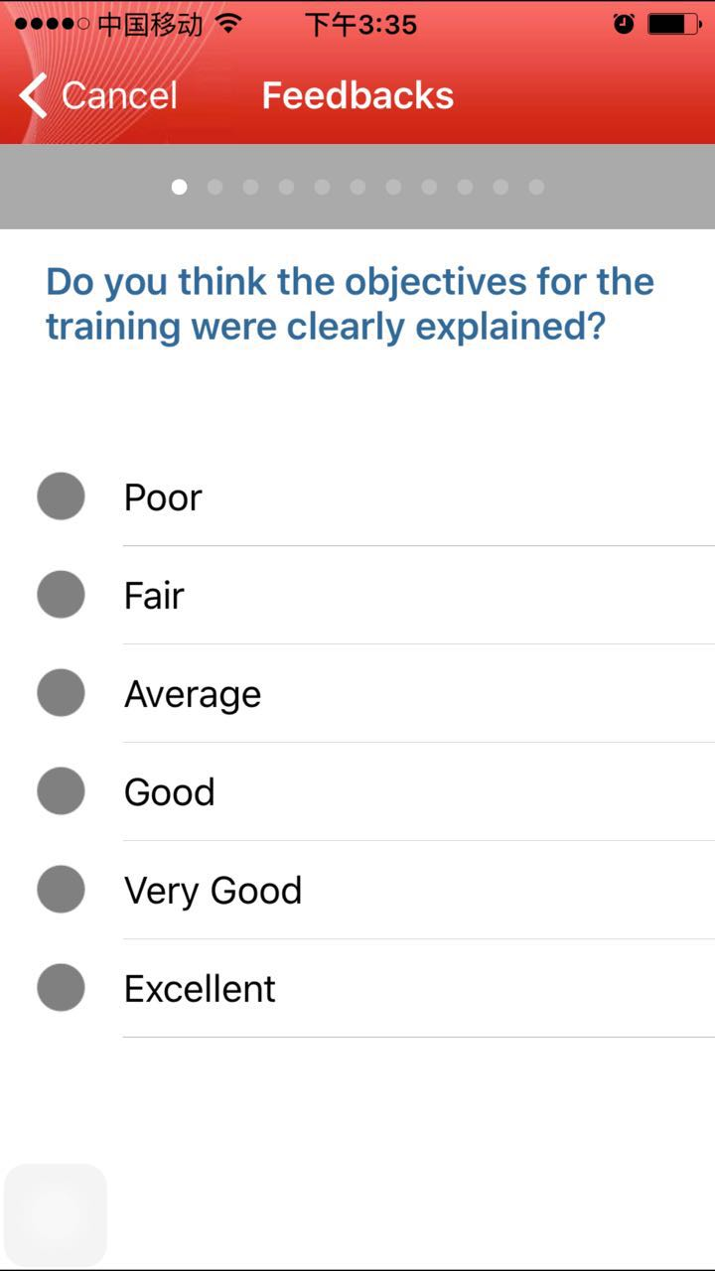
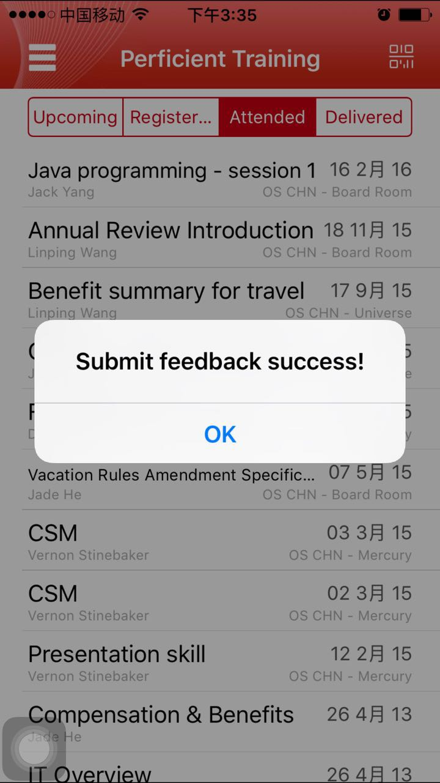
Training System - APP
Submit a feedback in training APP

Slide 20
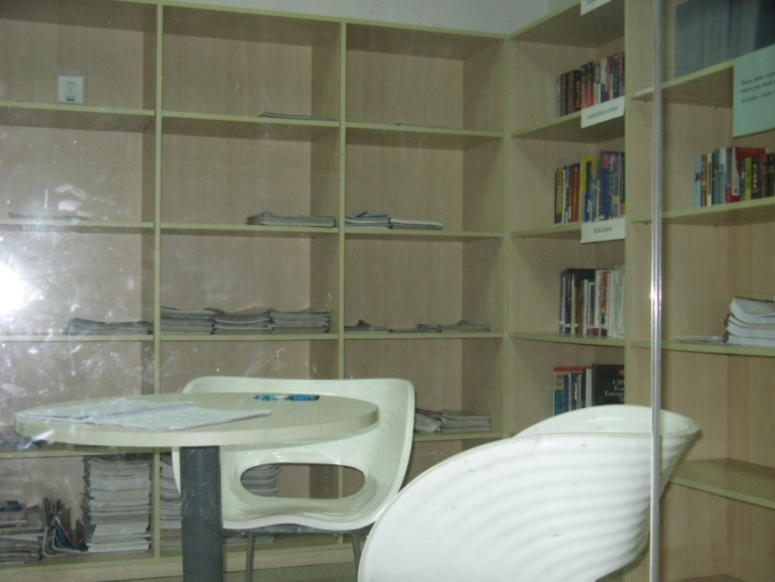
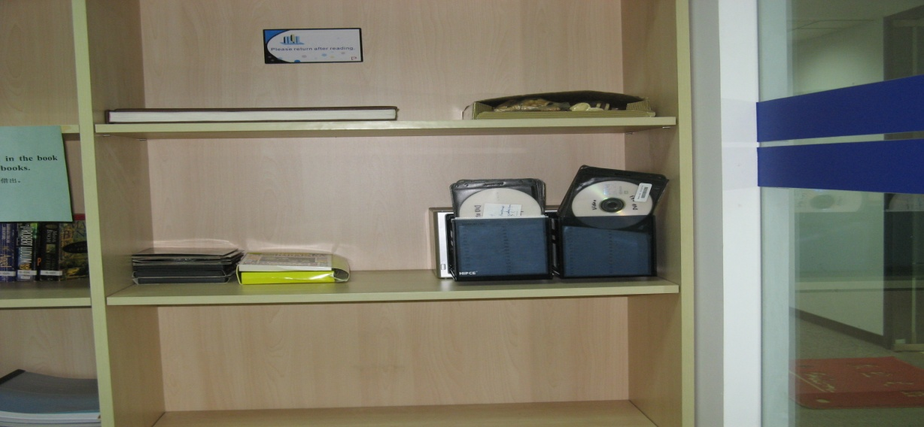
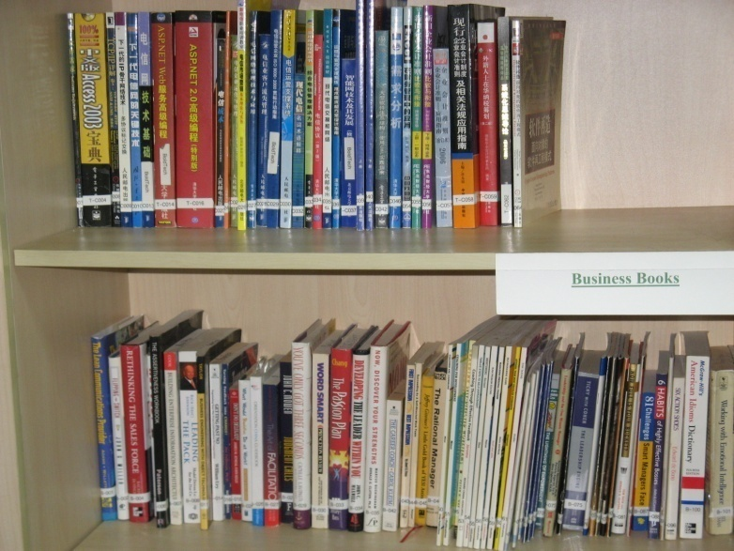
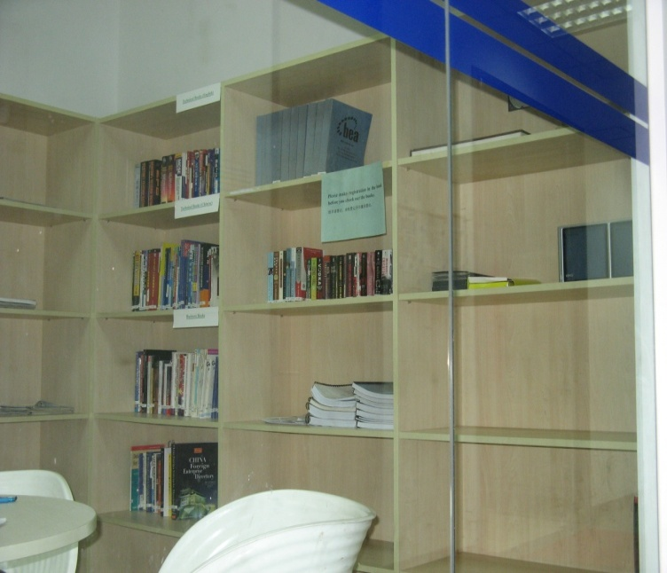
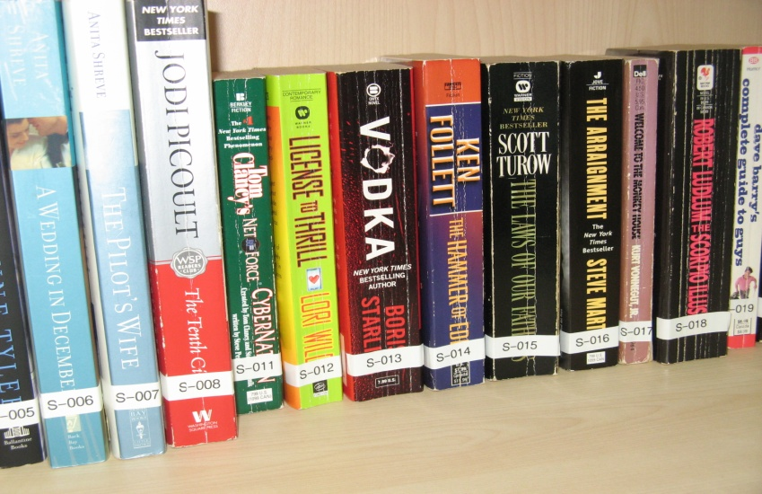
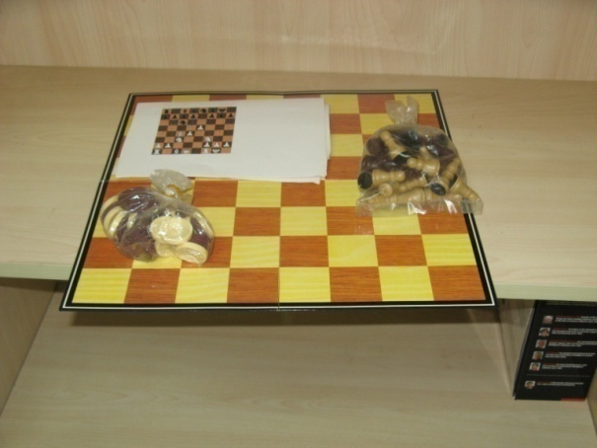
Library

Slide 21
Library
Our library was established since 2004. We now have 83 technology books written in Chinese (RMB 3,152.4); 83 technology books in English (RMB 1146.8 + US$2000) and over 100 business related books. We also have some English novels.
You can find Book List in Library system:
Perficient GDC Library system

Slide 22

Library
Please register when you borrow the books (or login library to check the books out by yourself);
After reading please put the books at the training coordinator’s desk instead of its original position, so that she can clear your borrowing information
Only two books can be borrowed at one time, so that others can have chance to read
Please don’t keep books longer than two month, other people may need them too
If you lose the book, please compensate the price of the book or buy a new copy of the same title to replace it in the library
instructions

Slide 23
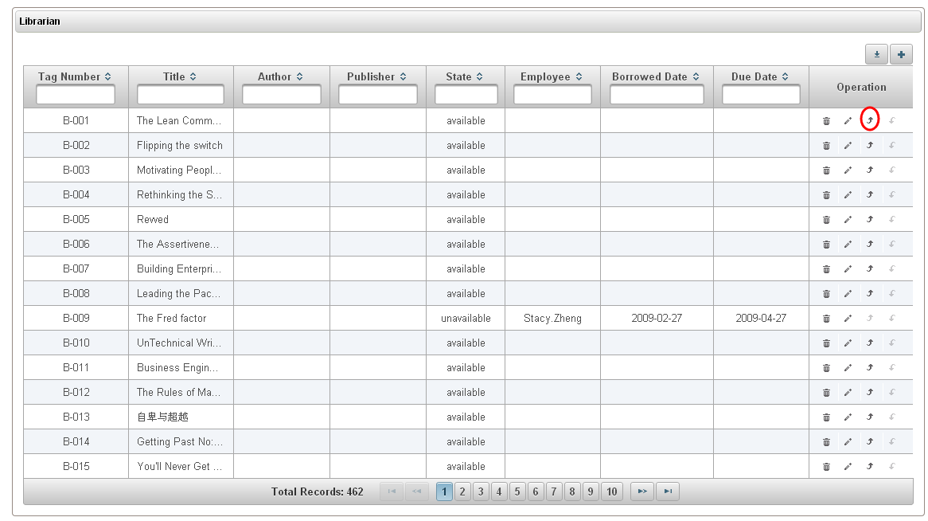
Library system
URL:
http://10.2.1.74:6080/login
TPT
Log in
My Page
Book list
APP in smart phone

Slide 24
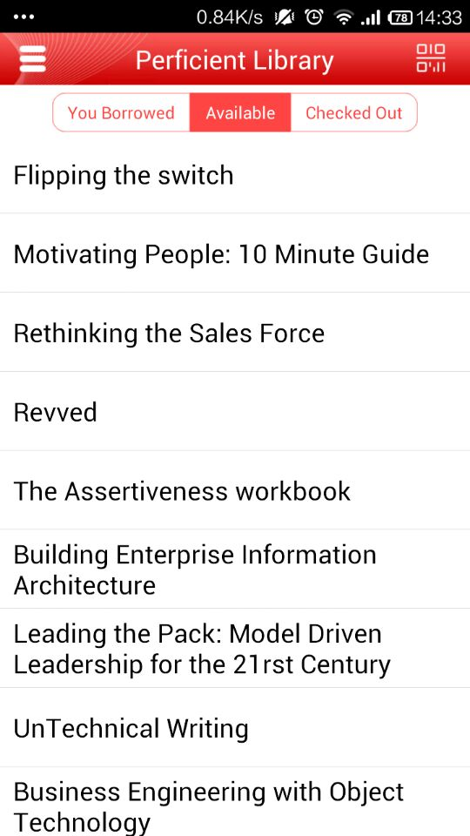
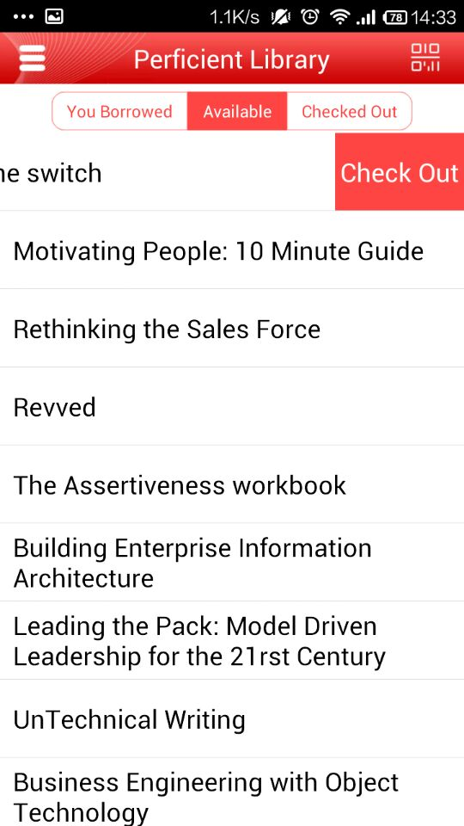
Library system - APP

Slide 25
Thank You !

